Slide 1
What the Fourth Do We Know? Examining Search and Seizure Knowledge
Dr. Joshua J. Reynolds – University of Scranton
Dr. Victoria Estrada-Reynolds – King’s College

Slide 2
Background
Research exists about legal knowledge in many domains
Medical marijuana laws in their own state (Mauro et al., 2019)
Students’ legal knowledge of sexual assault (Kimberly & Hardman, 2019)
Adolescents’ understanding of Miranda rights (Haney-Caron et al., 2023)
Very little research on what people know about search and seizure

Slide 3
Background
Why search and seizure?
Basic history and civic education
Fourth amendment
What can the police do or not do?
Compliance
Ramifications for Fourth Amendment violations
Perception of the law and knowledge may affect police legitimacy

Slide 4
Current research
Goals
Describe and explore what people know about search and seizure
Basic terms such as search and seizure, fundamental aspects (e.g., when a warrant is required), and routine applied contexts (e.g., what evidence can be admitted as search incident to a lawful arrest)
Examine what people know in different populations know:
General population
College students
Police officers

Slide 5
Method
Participants
General population – Prolific
n = 1,290
College students - Northeastern university in the U.S.
n = 202
Police officers – Prolific
n = 32
N = 1,524

Slide 6
Method
Materials
In percentile (0-100), how much do you think you know about the law, compared to all other people in the United States?
31 multiple choice items
Example Items:
In which of the following cases would a warrant probably NOT be needed?
A search for weapons after arresting a suspect
A search of a house
A search for drugs in all parts of a car after a traffic violation
A search of someone’s car after that person has refused consent
The Fourth Amendment contains two clauses. What are they?
The reasonableness clause and the warrants clause
The search clause and the seizure clause
The warrants clause and the power clause
The upper clause and the lower clause
Jake, a police officer, sees a man parked outside a closed jewelry store. He has a strong gut feeling that the man is up to something, so he asks the man to step out of his car and cuffs him. Which of the following is TRUE?
It is an INVALID arrest because Jake cannot arrest based on a ‘hunch’
It is an INVALID arrest because Jake did NOT have a reason to be near the jewelry store
It is a VALID arrest because the man voluntarily stepped out of his car
It is a VALID arrest because jewelry stores get special protection from the police
Demographics questions

Slide 7
Results – raw scores
All groups demonstrated proficiency in some areas
Correctly answered example of reasonable suspicion (>95.8%)
Some items participants performed poorly on across the board
The question about the two clauses in the Fourth Amendment was only correctly answered by 25% of police officers
One items was answered more correctly by the other groups than police
Half of the police officers in the sample responded that it was okay that a police officer arrest someone because the person voluntarily stepped out of a car, despite no probable cause.

Slide 8
Results - IRT
Item Response Analysis
Unidimensionality was investigated VSS, Velicer MAP, likelihood ratio test, model comparison (AIC, BIC, SABIC, and HQ), and DETECT indices
Evidence of nonignorable multidimensionality
Given the test content and observed cross-loading item structure, correlated traits models were explored, specifically within-item multidimensional models
Within-item multidimensionality can occur when there are items that are indicators for more than one dimension (Adams et al., 1997; Reckase, 2009)
Thus, the item itself is multidimensional.

Slide 9
Results - IRT
Extensive model comparison
The final model was a 3-dimension 3PL
Global fit indices suggested strong fit (M₂ = 313.45, df = 291, p = .17, RMSEA = .007 95% CI [.000, .013], SRMSR = .026, TLI = .992, CFI = .995
Dimension 1 – proficiency in terms and rules of search and seizure law
Dimension 2 – proficiency in technical/textbook search and seizure law definitions
Dimension 3 – proficiency in context specific and applied search and seizure law

Slide 10
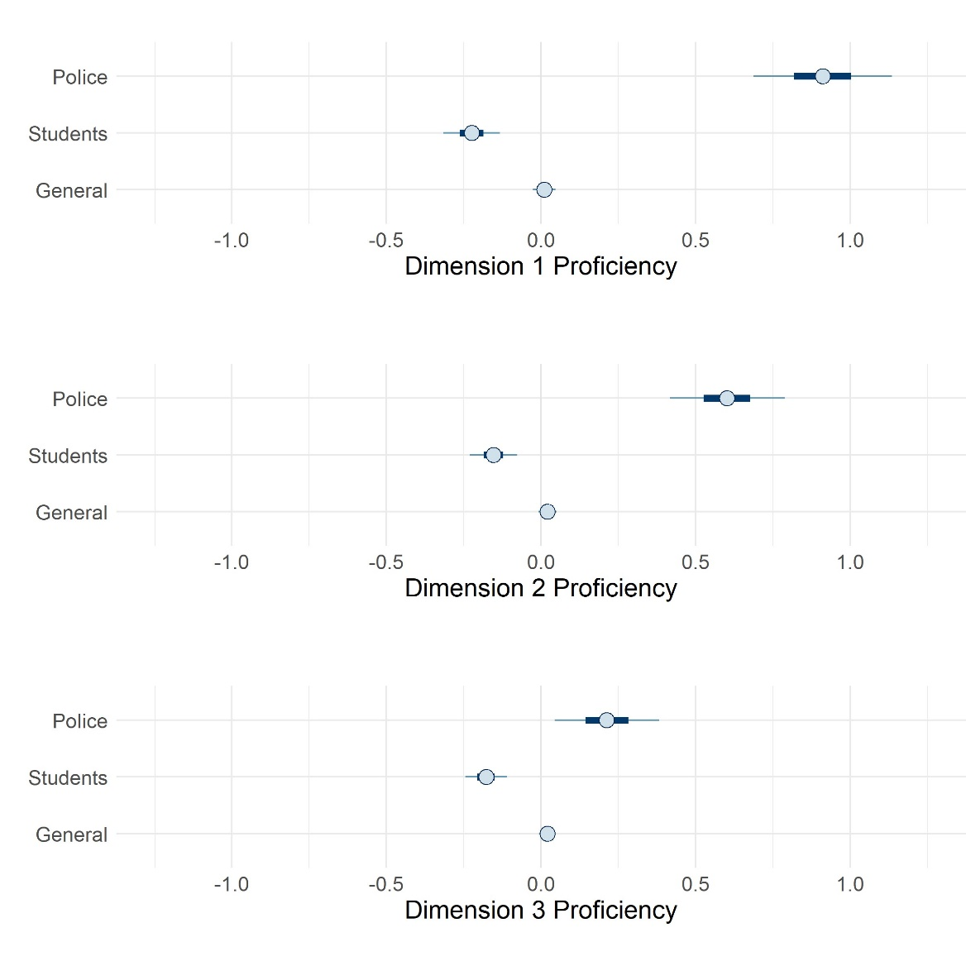
Results – Bayesian modeling
Terms and rules of search and seizure law
Technical/textbook search and seizure law definitions
Context specific and applied search and seizure law

Slide 11
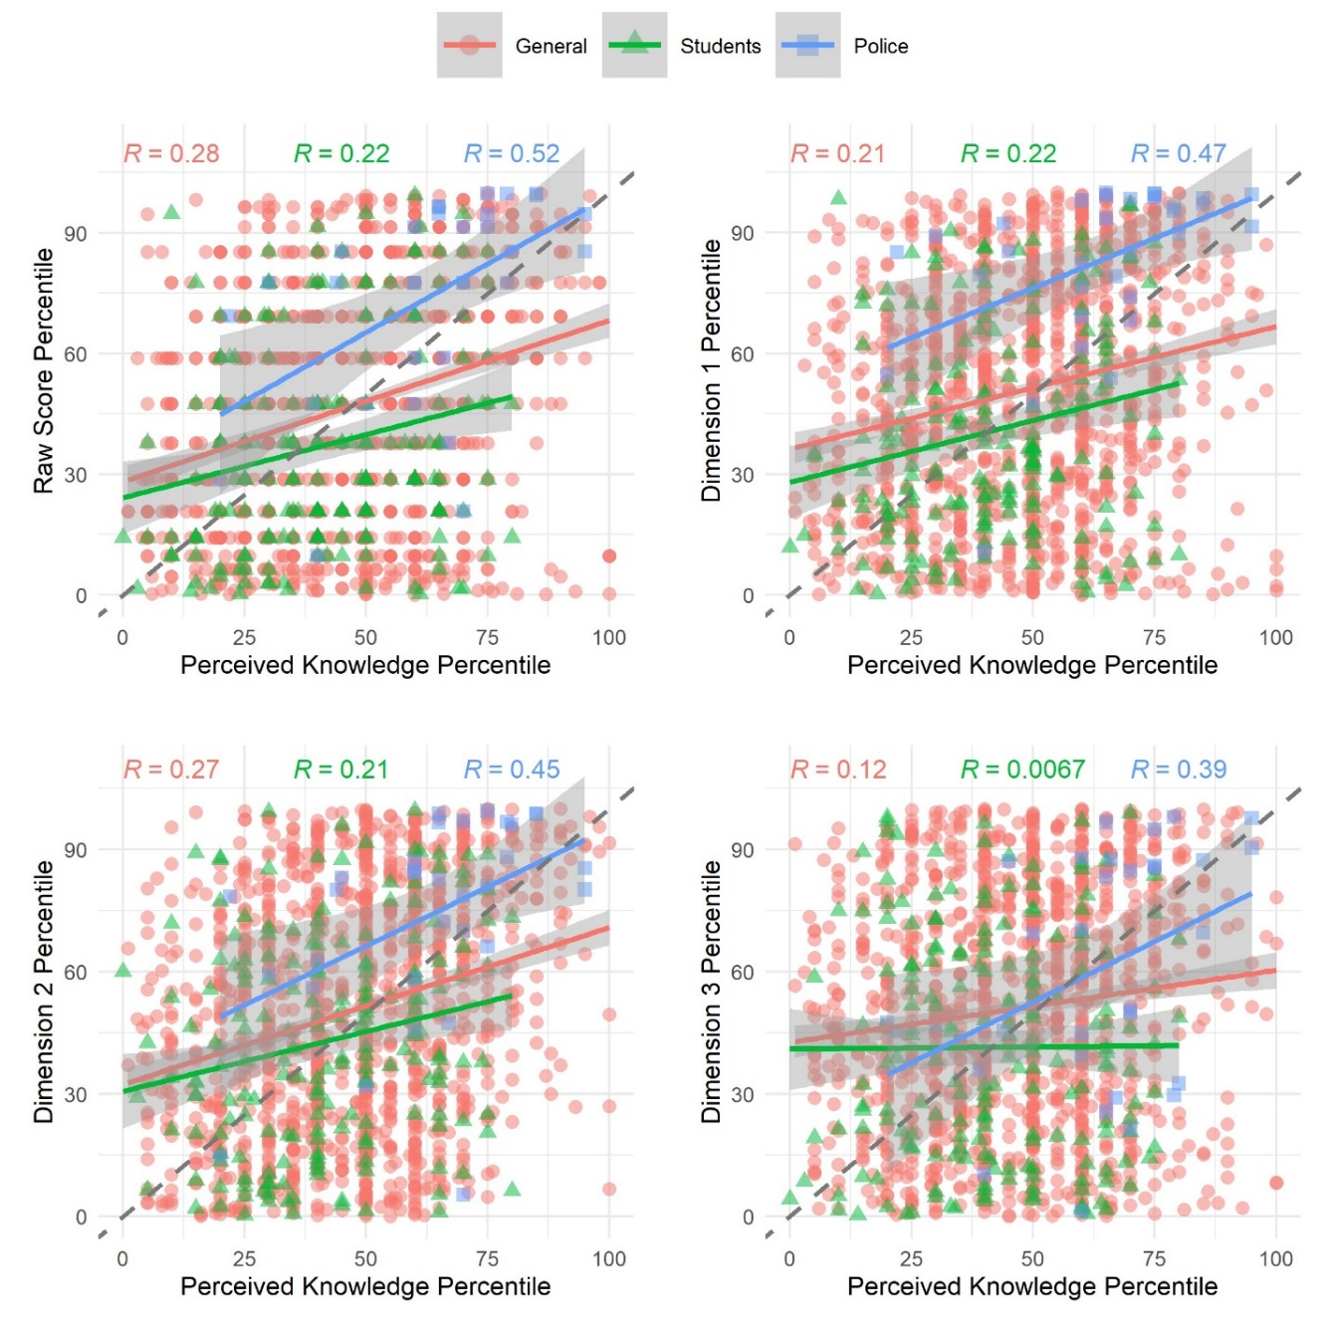
Results – perception of knowledge
Most people were not that well calibrated in terms of their knowledge of the law and their actual search and seizure knowledge, but police officers were better calibrated

Slide 12
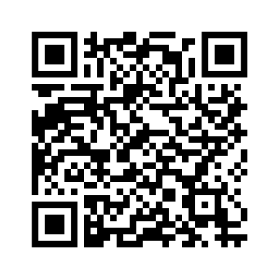
Final thoughts
We have much to learn but we have a strong set of items for future research including for instrument development
Thank you to AP-LS for the ECP grant
Joshua.Reynolds@scranton.edu
https://www.reynolds-legal-psych.com/lab-forensic-and-legal-psychology

